Slide 1
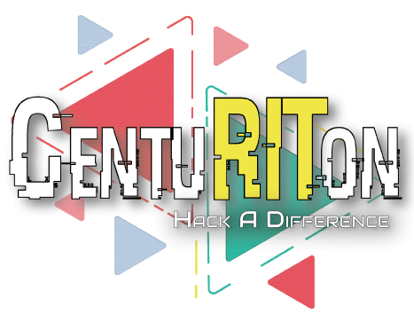
#HACK_A_DIFFERENCE
“Hacking human’s imparity given by God using Tech”

Slide 2
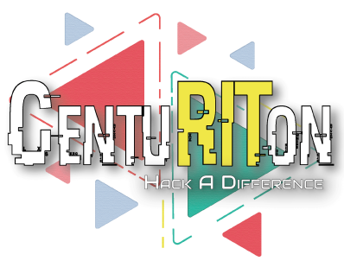
Team - Igniters
Kushagra Pandya
Poorvika Gupta
Sweta Goswami
Yash Srivastava

Slide 3

What’s Ahead?
Problem Statement
How Hacked?
Technology Used
Methodology
Working Model
Utility
What’s different?
Impact on the society
Time-to-Market
Product Plan
Conclusion

Slide 4
Problem Statement
Normal people have a difficult time communicating with dumb individuals since they cannot grasp sign language, especially when they come from various sections of the nation.

Slide 5
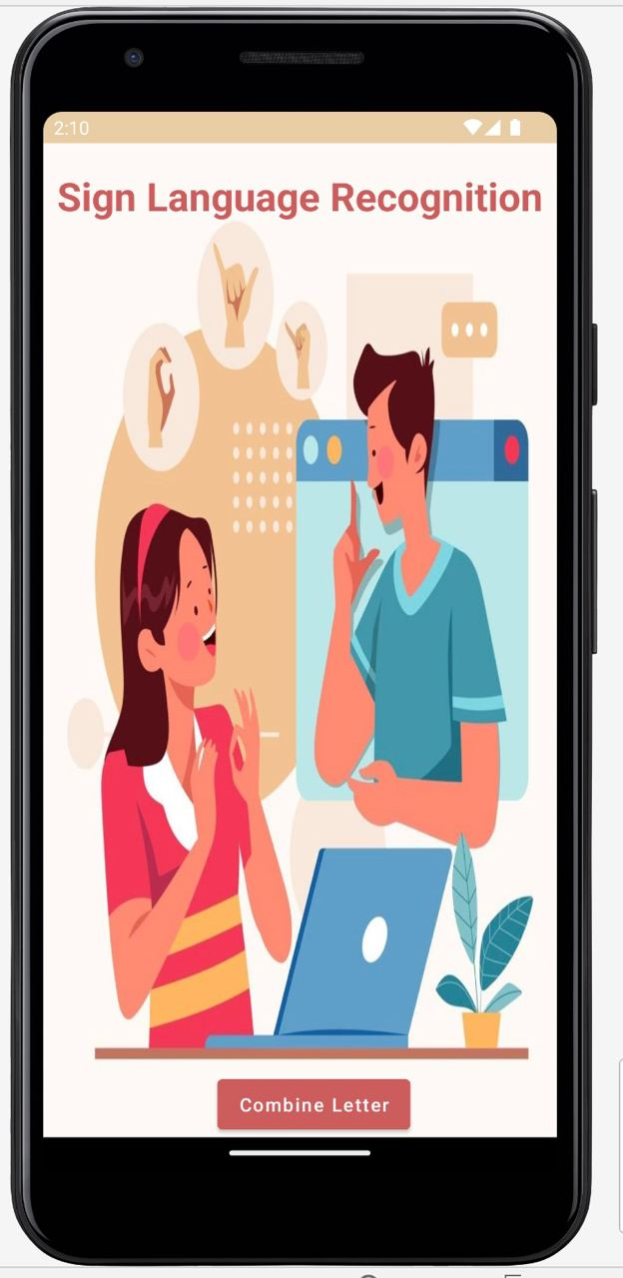
How Hacked?
Bringing Together
Real-Time application to convert
Sign Language into Speech

Slide 6
Technology Used
TensorFlow lite
Android Studio
Java
Python
Extensible Markup Language
Computer Vision(Open CV)
Natural Language Processing

Slide 7

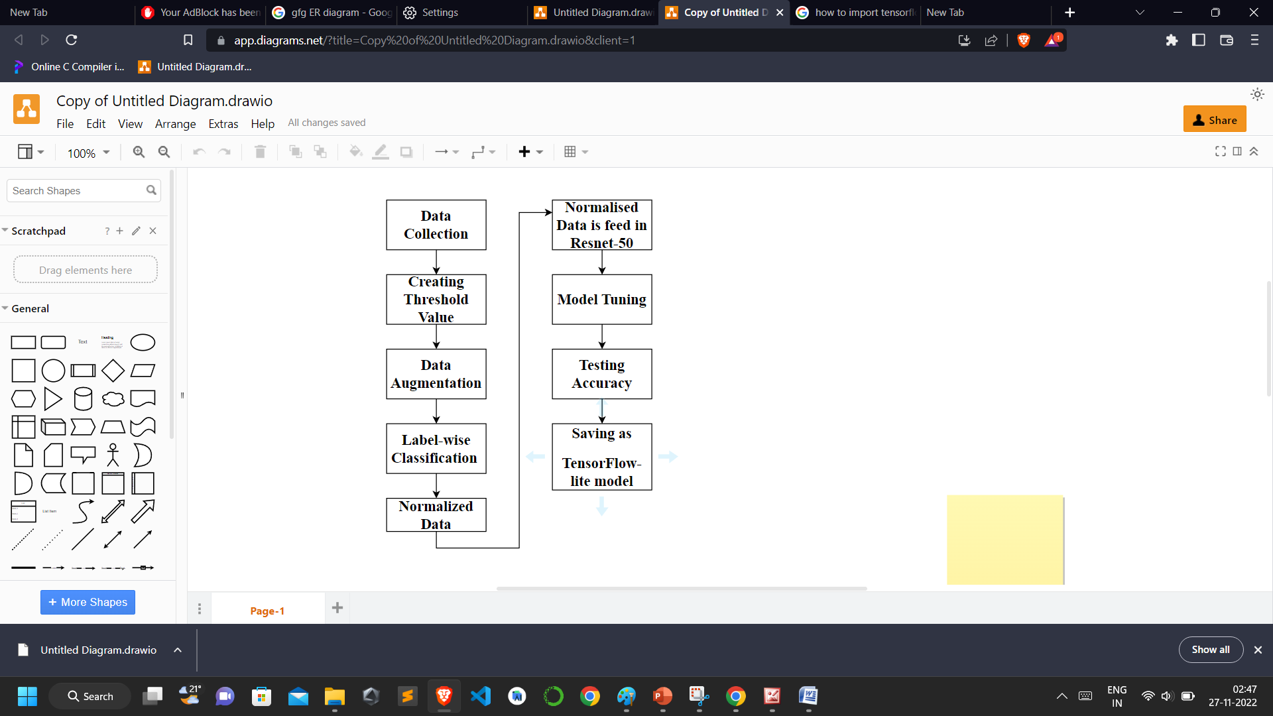
Methodology
Flowchart of the Deep Learning Model

Slide 8
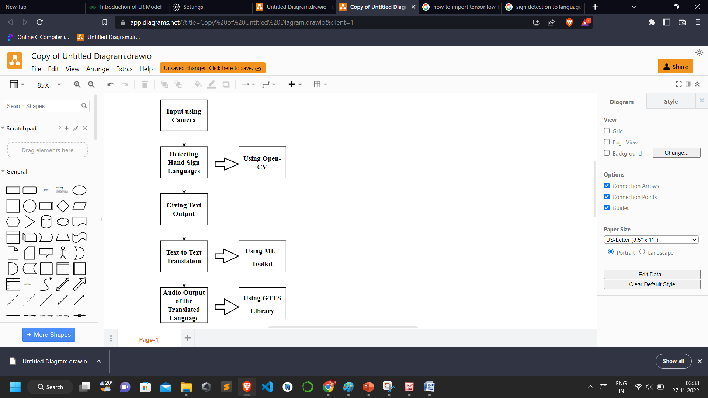
Methodology
Work Flow of our Android Application

Slide 9

Working Model

Slide 10
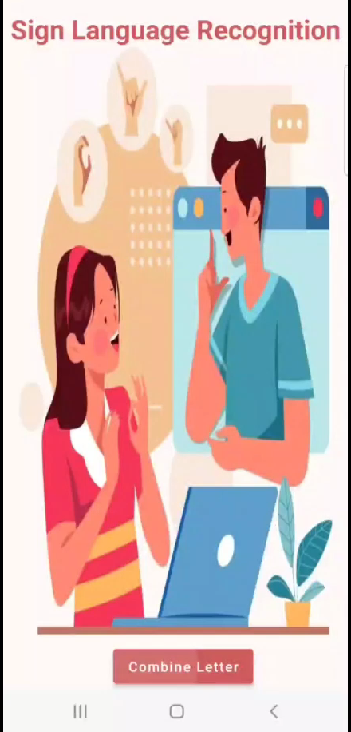
https://github.com/poorvika11/IGNITERS

Slide 11
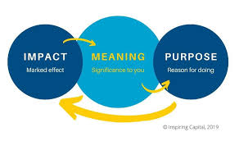
Utility
Bridging communication gap
Industry Effective
Revolutionary for society

Slide 12

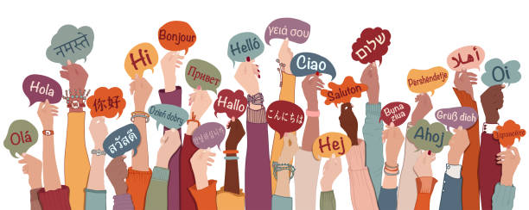
What’s different?
No such application exists for converting sign language to the speech of different languages.
Providing all services in one app to disabled ones.

Slide 13
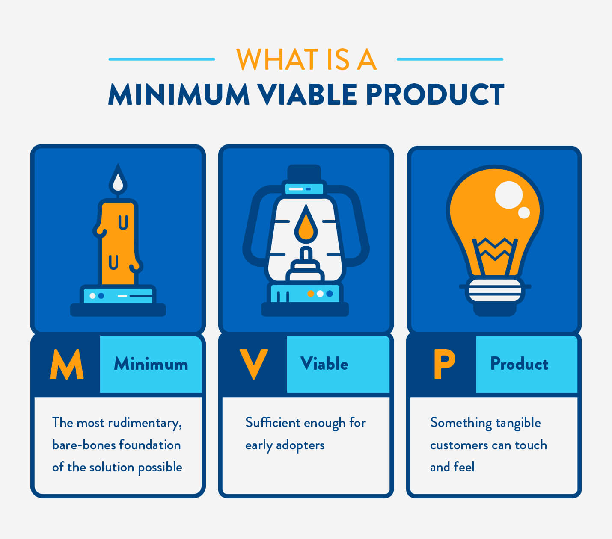
Time-to-Market
News channels
SaaS to NGOs
Language Subscription

Slide 14
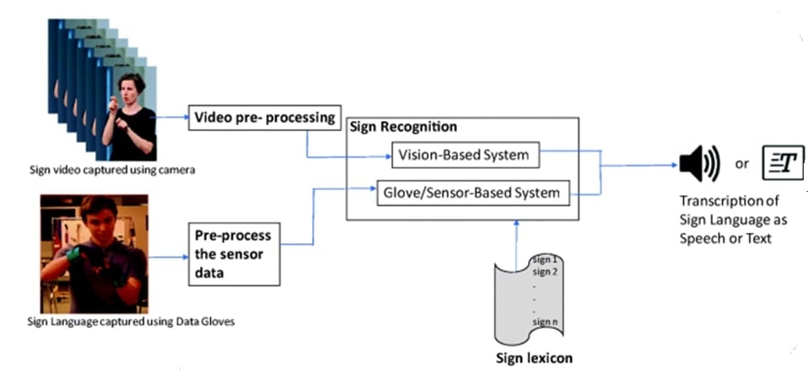
Recognition of ISL word and sentence level
Implementing Conversion of Braille Language to Speech in lenses.
Upgradation of services for disabled ones
We can intrude these technologies to gloves, IoT
Product Plan

Slide 15

A person who is severely impaired never knows his hidden sources of strength until he is treated like a normal human being and encouraged to shape his own life. -Helen Keller
Conclusion

